Slide 1




Slide 2
The Talking Points:
Why Start-Up?
How to start a Start-up?
Funding
Start-up Environment
Opportunities

Slide 3
Start UP
An Young Company that is just beginning to develop. Startups are usually small and initially financed and operated by a handful of founders or one individual. These companies offer a product or service that is not currently being offered elsewhere in the market.

Slide 4

Why Start-up?
Your are your own boss
you can set your own hours
do work that really matters to you.
Software Recession

Slide 5
Why Start-up?
Passion towards Business
Self Employment
Quick Returns
Fed up with your Job

Slide 6

“Build your own dreams not others”

Slide 7


Slide 8

awesome story of samosa Wala

Slide 9

COOLIE’S SON WHO SET UP 100 CRORE COMPANY WITH JUST 25,000

Slide 10


Slide 11
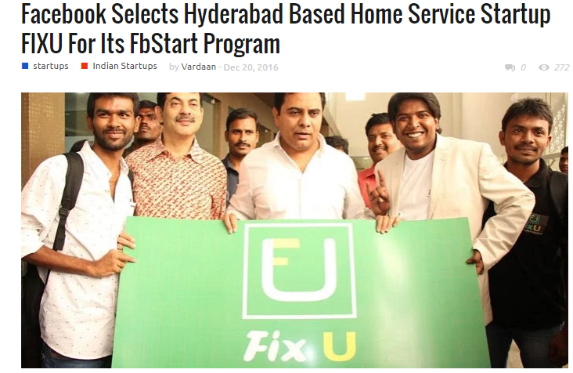

Slide 12

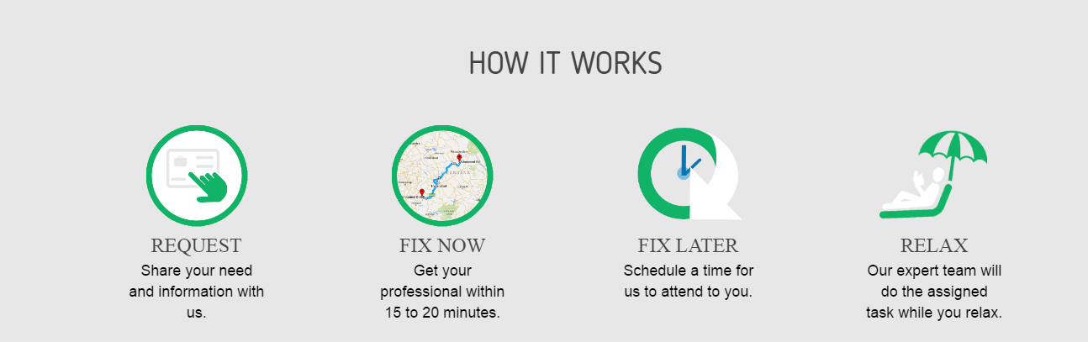

Slide 13

Start-ups which have become our favourite!
Google
Uber
OLA
Dropbox
Snapchat
Facebook
Spotify

Slide 14

Our own indian start-ups!
Flipkart
Swiggy
Snapdeal
Redbus
Paytm
Oyo Rooms
Zomato
MakeMyTrip
BharathMatrimony

Slide 15
How to start a start-up??

Slide 16
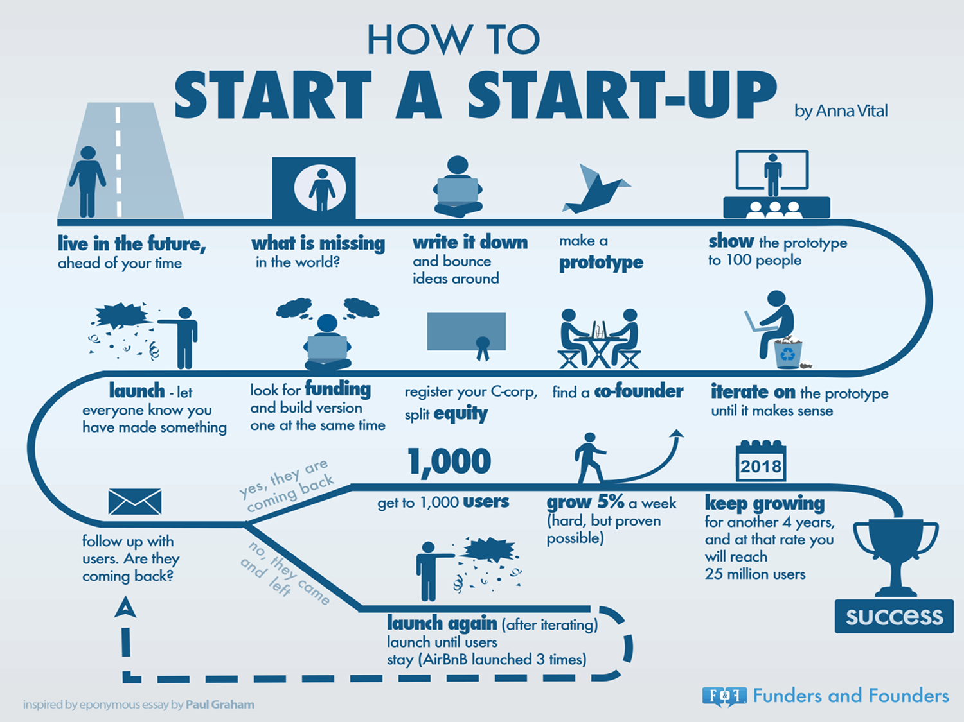

Slide 17

Funding in startups!!

Slide 18
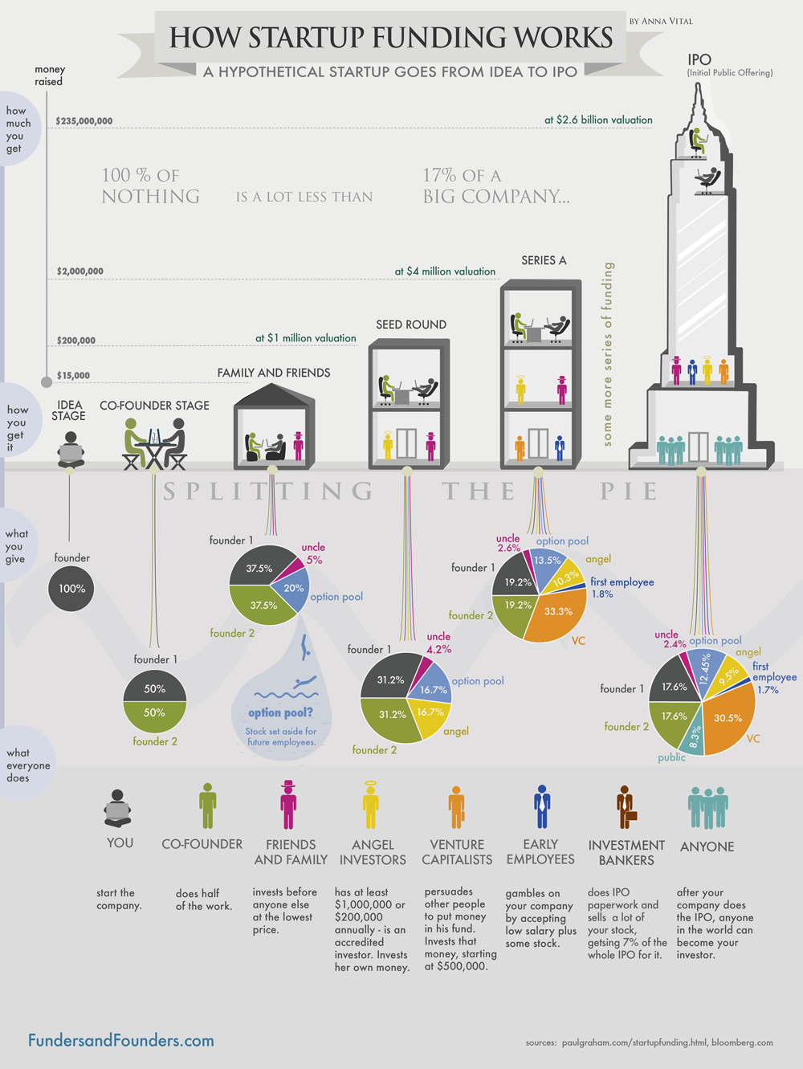

Slide 20
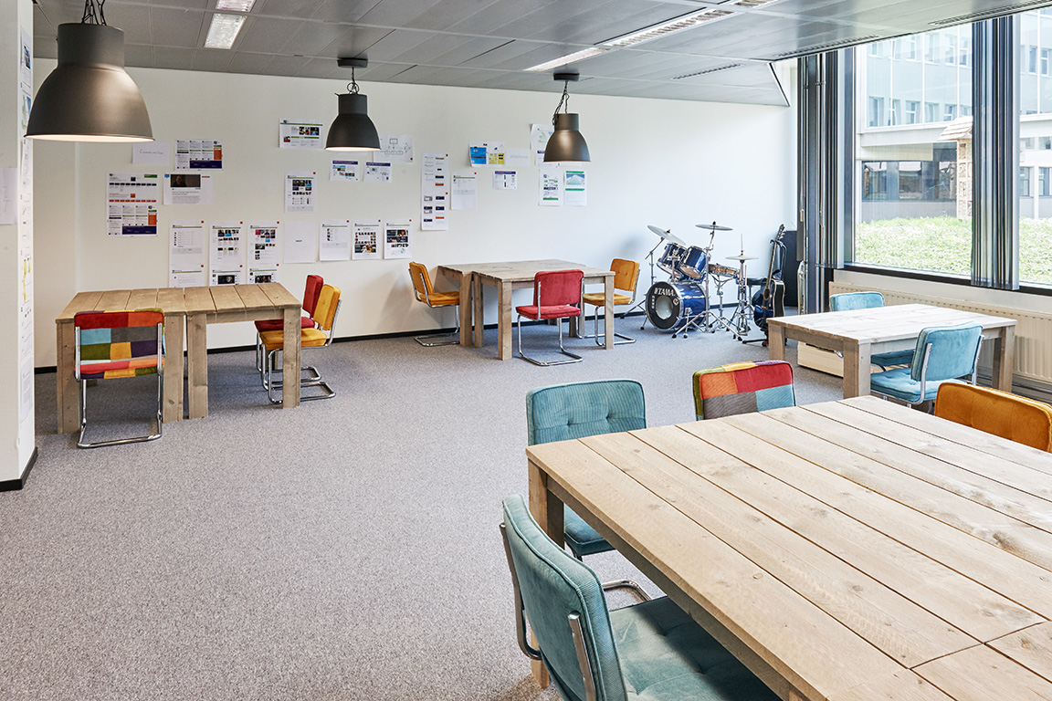
Startup environment

Slide 21
A Sense Of Ownership And Responsibility
Opportunities And Recognition
Learn From Innovators
Impact and Involvement
Lack of hierarchy
A fun work environment

Slide 22

opportunities
Talent Is Inclined To Work With Startups
Indian and Foreign Investors Making Huge Investments in Startups
Government Funds for Startup firms

Slide 23
opportunities
Startup India Initiative
Make in India Initiative
MUDRA Yojna
SETU Fund
E-biz portal
Royalty Tax

Slide 24

THANK you!!!

